Slide 1
LineUp
Jane Li, Xinhao Luo, Yitao Shen, Tong Wu

Slide 2
Demo
Notes:
Jane / Tong

Slide 3
Planning
Uses cases
User stories
User Personas
UI Mock-Up
Notes:
Jane

Slide 4
User Interface
Notes:
Jane / Tong

Slide 5
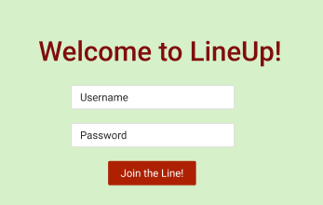
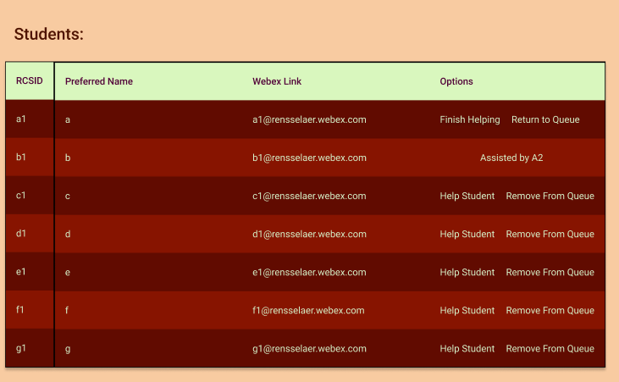
Data Flow in Mockup
Register/Login
Event Management
Queue Management
Notes:
Tong

Slide 6
Database Schema

Slide 7
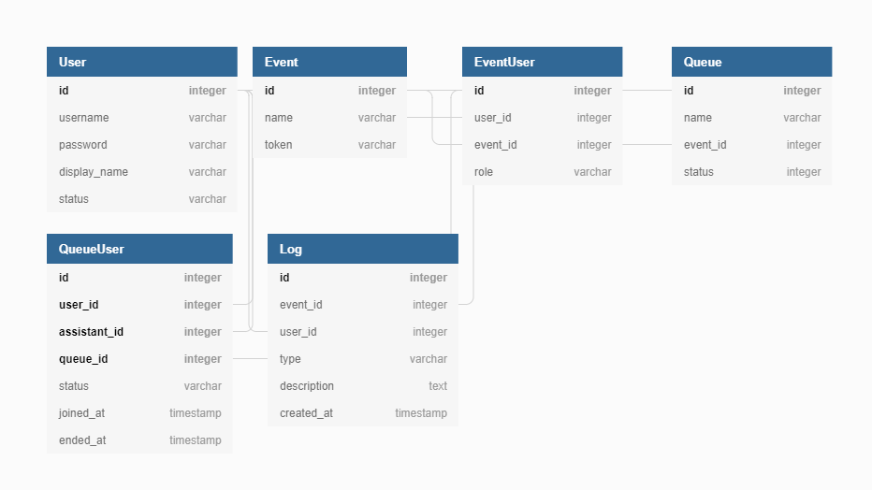
Database Schema
Notes:
Tong

Slide 8

Front-End

Slide 9


Vue.js + Bootstrap
What are they?
Vue is a progressive JS framework for WebApp
Bootstrap is a modern UI library designed with accessibility in mind
Why using them?
Lift the server pressure from render templates/save mobile device’s cellular network
WebApp can be cached and reuse without loading static resource again
Decouple frontend HTML code with Java backend logic
Potential to turn into native mobile App/embed into other system (Follow the API standard)
Notes:
Xinhao

Slide 10
Workflow
User
1. Request CDN
Compiled Vue.js WebApp
2. Download & Cache App
Java
App Endpoint
3. Request JSON Object and parse response on demand
(Will talk more later in backend section)

Slide 11
Back-End

Slide 12
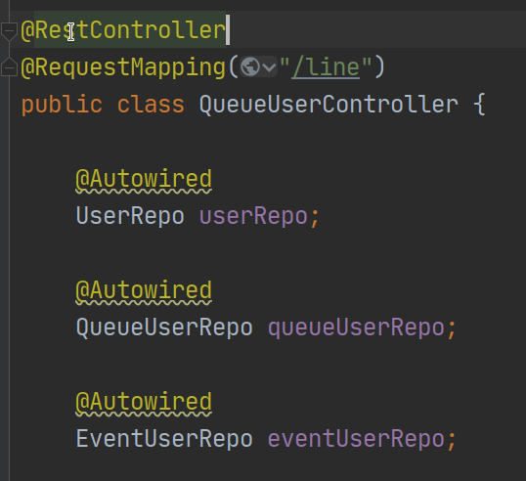
SpringBoot and Web
What is Spring
Spring a bundle of library that improve efficiency and ease to write Java code for various usage
Main reasons we use Spring
Out-of-the-box environment setting and auto configuration
Flexibility to alter/change components based on needs
Mature framework used by lots of companies and actively maintained
Rich documentations and best practice for different scenarios
Main Structures
Follow MVC, where View is in form of JSON
Notes:
Xinhao

Slide 13
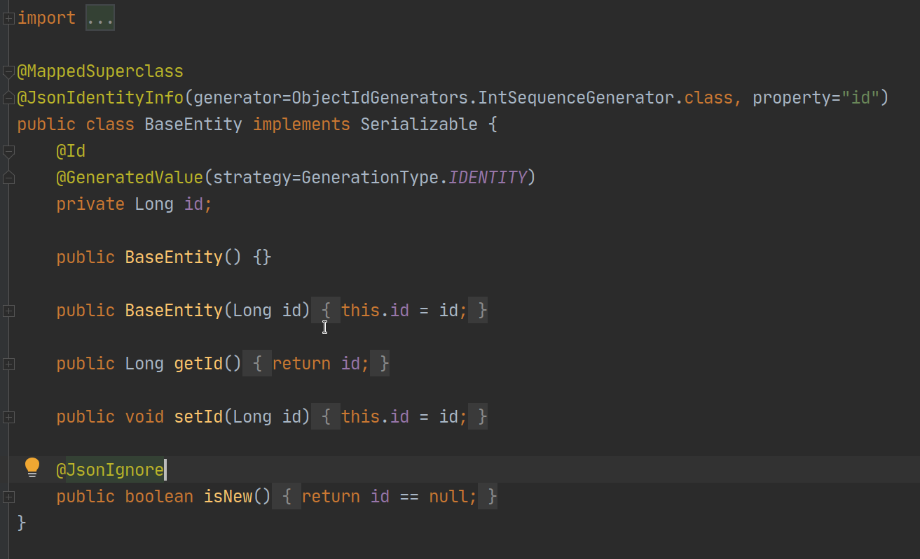
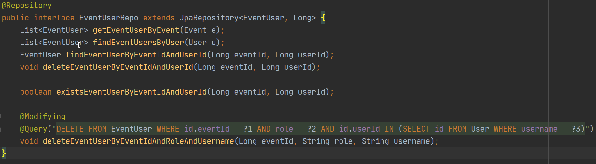
Database & Data Representation
Make use of Java Persistence API (provider: Hibernate)
The standard way of persisting Java objects into RDB
Two parts: mapping and EntityManager
Database: H2
Relational Database
Lightweight
Embedded in the App
Memory/File persist mode

Slide 14

Spring Security
UserDetail implementation
Implement the Interface provided by Spring Security
Packaged in `org.springframework.security.core.userdetails`
Store the hash value of the plain-text password
Password Encode
Using class PasswordEncoder to hash the plain-text password
Packaged in `org.springframework.security.crypto.bcrypt`
Notes:
Yitao

Slide 15
API Design
Not really follow Restful since time limits and flexibility
More “RPCful” (Remote Procedure Calls)
Notes:
Yitao

Slide 16
Testing

Slide 17
Unit Testing
Auth: Process the user registration, logging in/out requests, and handle the invalid input
Event: Represents the course item or something equivalent, which contains multiple queues
Mixins: Coordinate the form submission
Router: Coordinate the website path, check authentication before move from one router to another
… ...
Notes:
Yitao

Slide 18
Frontend Testing
Testing by using the application
Using the user scenarios to create the test cases
Checking that the website will respond as expected towards typical user inputs
Listed the steps of the tests in the test cases to allow for recreating the results.
Notes:
Jane

Slide 19
Documentation

Slide 20
Documentation
User Manuals
Test Manuals
JavaDocs
Readme
Notes:
Jane

Slide 21
Thank you for watching!

